Slide 1

JAVA VISUAL EDITOR OOM-C3-PROJECT
Piyush Agarwal(IIT2020012)
Tarun Dabi(IIT2020045)
Ankit Jha(IIT2020049)
Rishabh Singal(IIT2020078)

Slide 2
Abstract
We have been asked to develop to a visual editor for JAVA program to compile ,run and edit the JAVA program. Like other Editor in Market this Project is similar with basic features like Menu, Edit, Tools ,Find ,About.
Developing this Mini - Project Helped Us to gain knowledge on visual editor, java programming, compiler code, etc.
We Have Used Swing, Java Technology to Develop it.

Slide 3
WHAT IS A COMPILER ?
A compiler is software (a program) that translates a high-level programming language to machine language
A simple representation would be:Source Code ----> Compiler -----> Machine Language (Object File)
It's not as simple as an assembler translator.
A compiler has to perform several steps to produce an object file in machine code form.

Slide 4
Use CASE DIAGRAM
A use case diagram is a dynamic or behavior diagram in UML. Use case diagrams model the functionality of a system using actors and use cases. Use cases are a set of actions, services, and functions that the system needs to perform.
https://lucid.app/lucidchart/f7dd4a56-9baa-46a6-a047-fc77730b497d/edit?viewport_loc=-10%2C-10%2C1707%2C821%2C0_0&invitationId=inv_80af03d2-4777-4bf8-bf9e-5d545d2820a0

Slide 5
CLASS DIAGRAM
Class diagram is a static diagram. It represents the static view of an application. Class diagram is not only used for visualizing, describing, and documenting. different aspects of a system but also for constructing executable code of the software application
.
https://lucid.app/lucidchart/aeeac37d-b761-4013-b6d7-209460a9982c/edit?viewport_loc=-10%2C-10%2C1707%2C773%2C0_0&invitationId=inv_06e36df9-70d9-4c3c-9d3d-103d966f0885
Class diagram describes the attributes and operations of a class and also the constraints imposed on the system. The class diagrams are widely used in the modeling of object oriented systems because they are the only UML diagrams, which can be mapped directly with object-oriented languages

Slide 6
CRC CARDS
Class-Responsibility Collaborator (CRC) card visualize classes in card-like presentation. Each CRC card contains information like the description of class, its attributes and responsibility. A CRC card diagram is a holder of these cards.
https://lucid.app/lucidchart/d7b1d3f3-04b0-4a8a-825f-038802830134/edit?from_docslist=true&page=0_0#

Slide 7
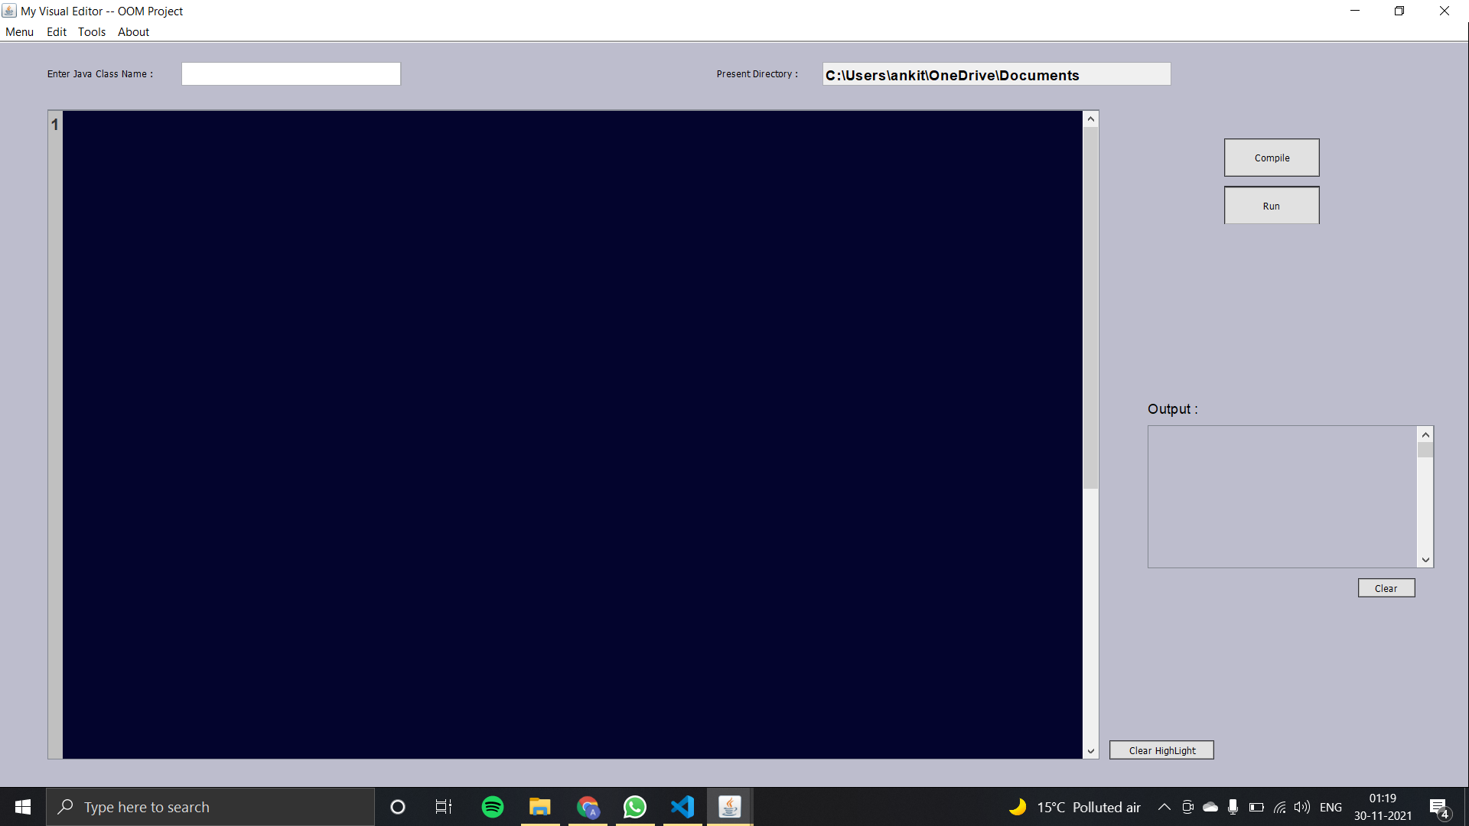
Main screen

Slide 8
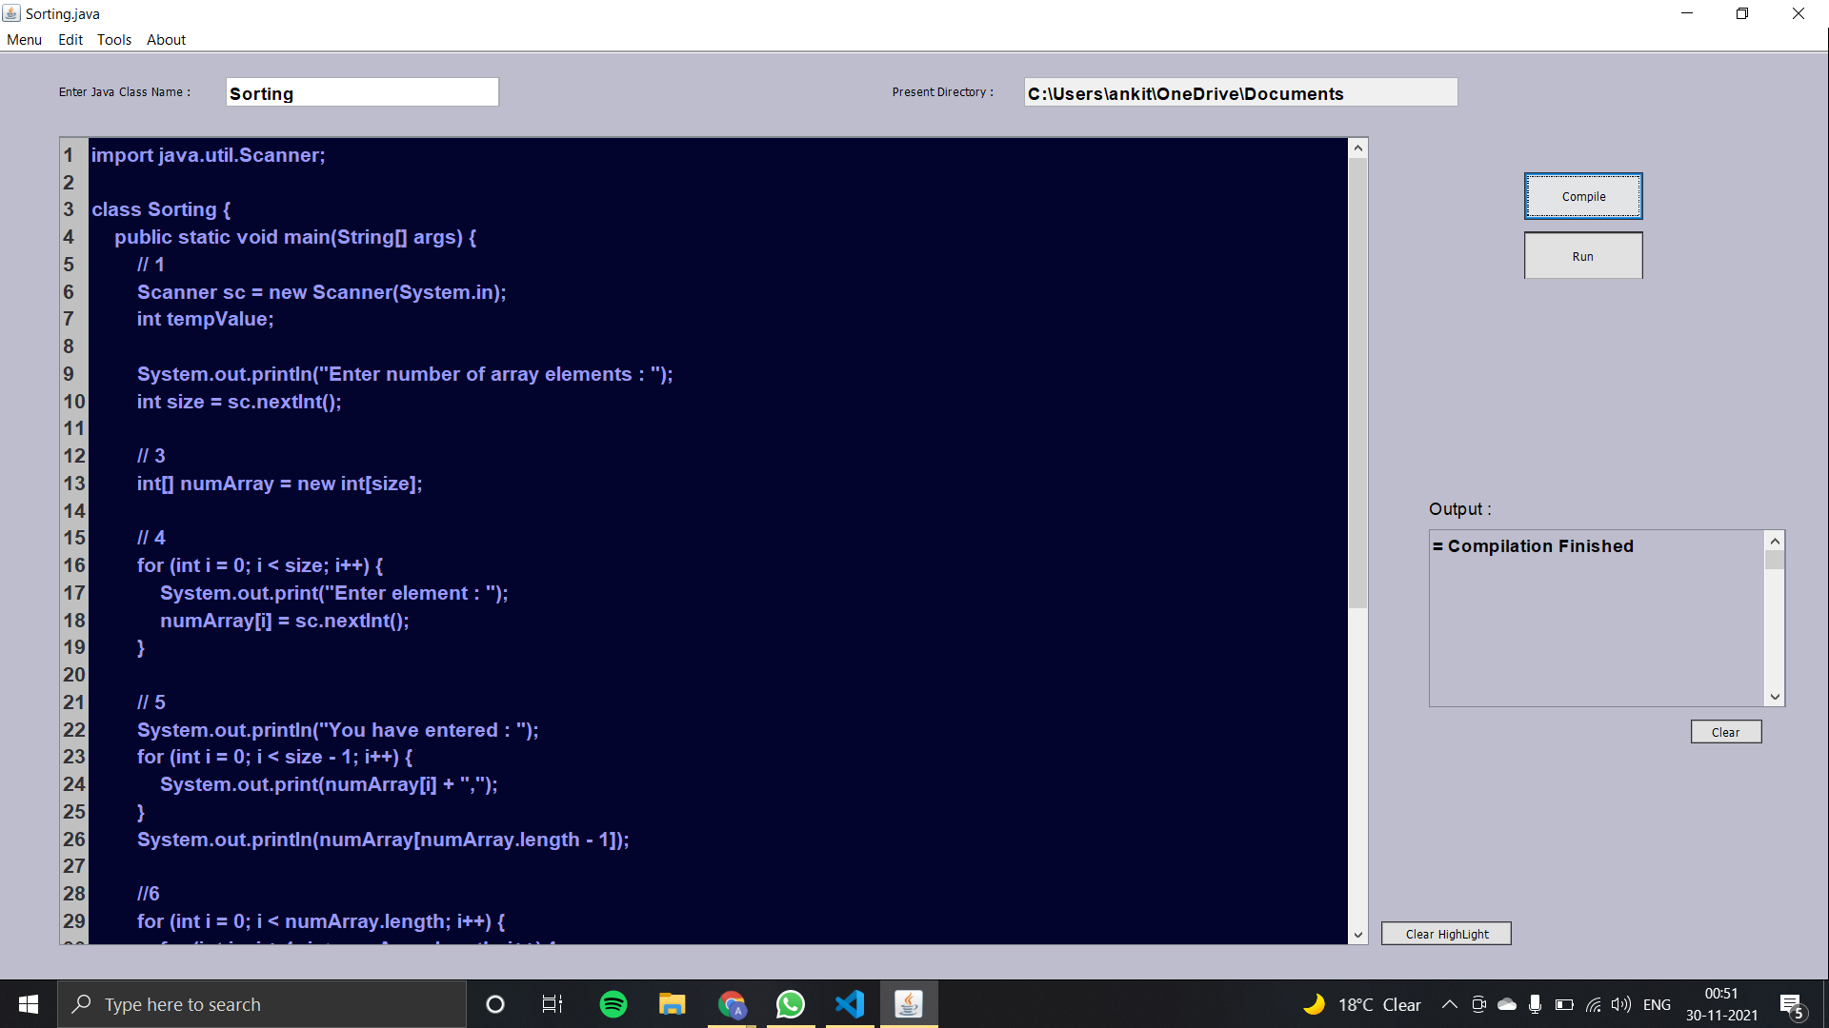
Compiled program

Slide 9
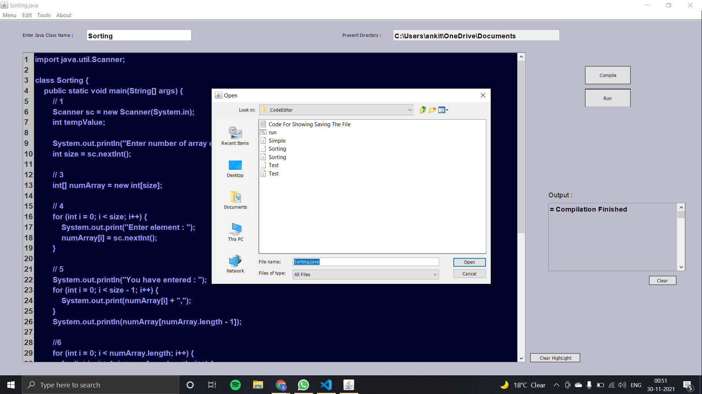
Opening a file

Slide 10
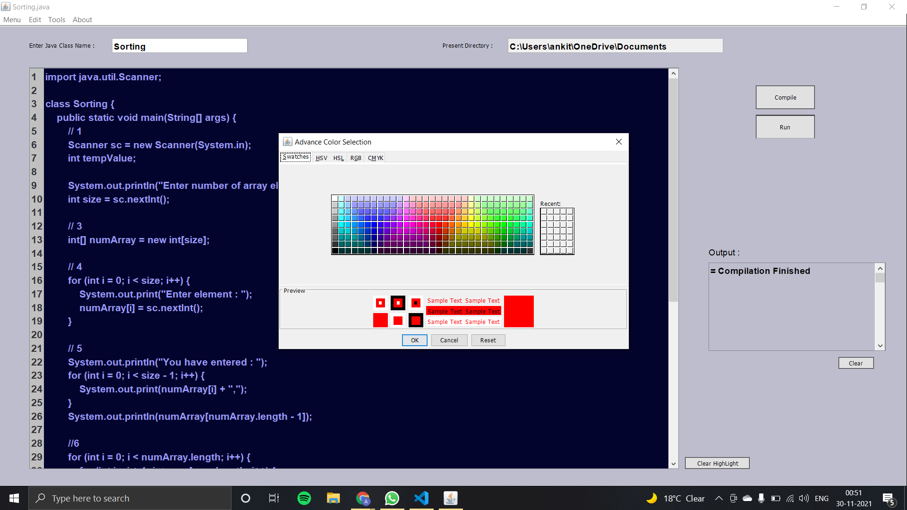
Text color settings

Slide 11
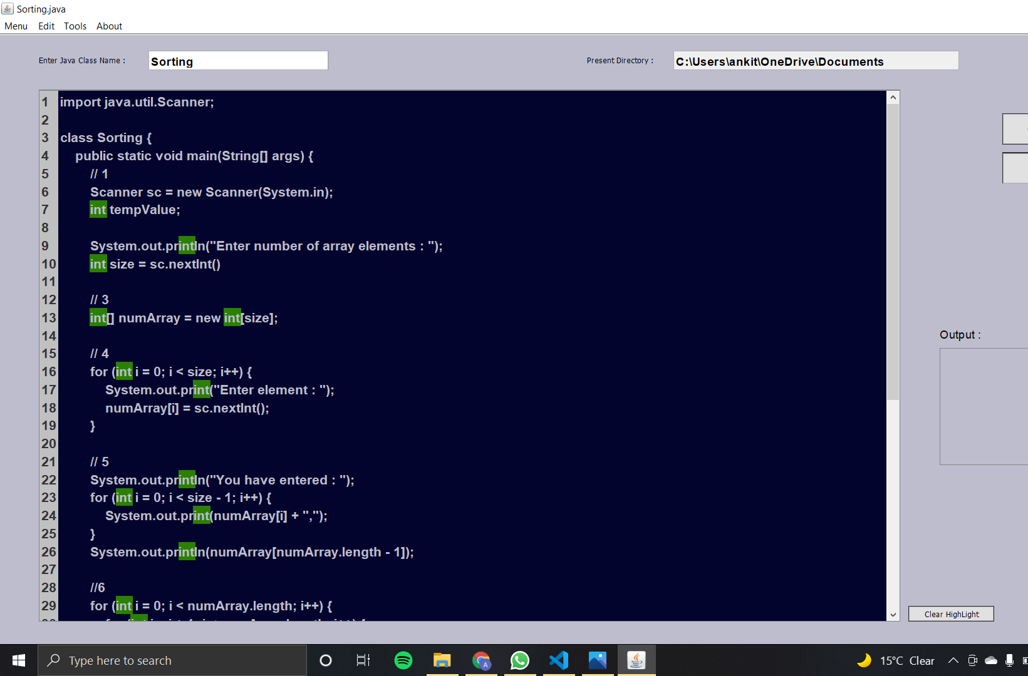
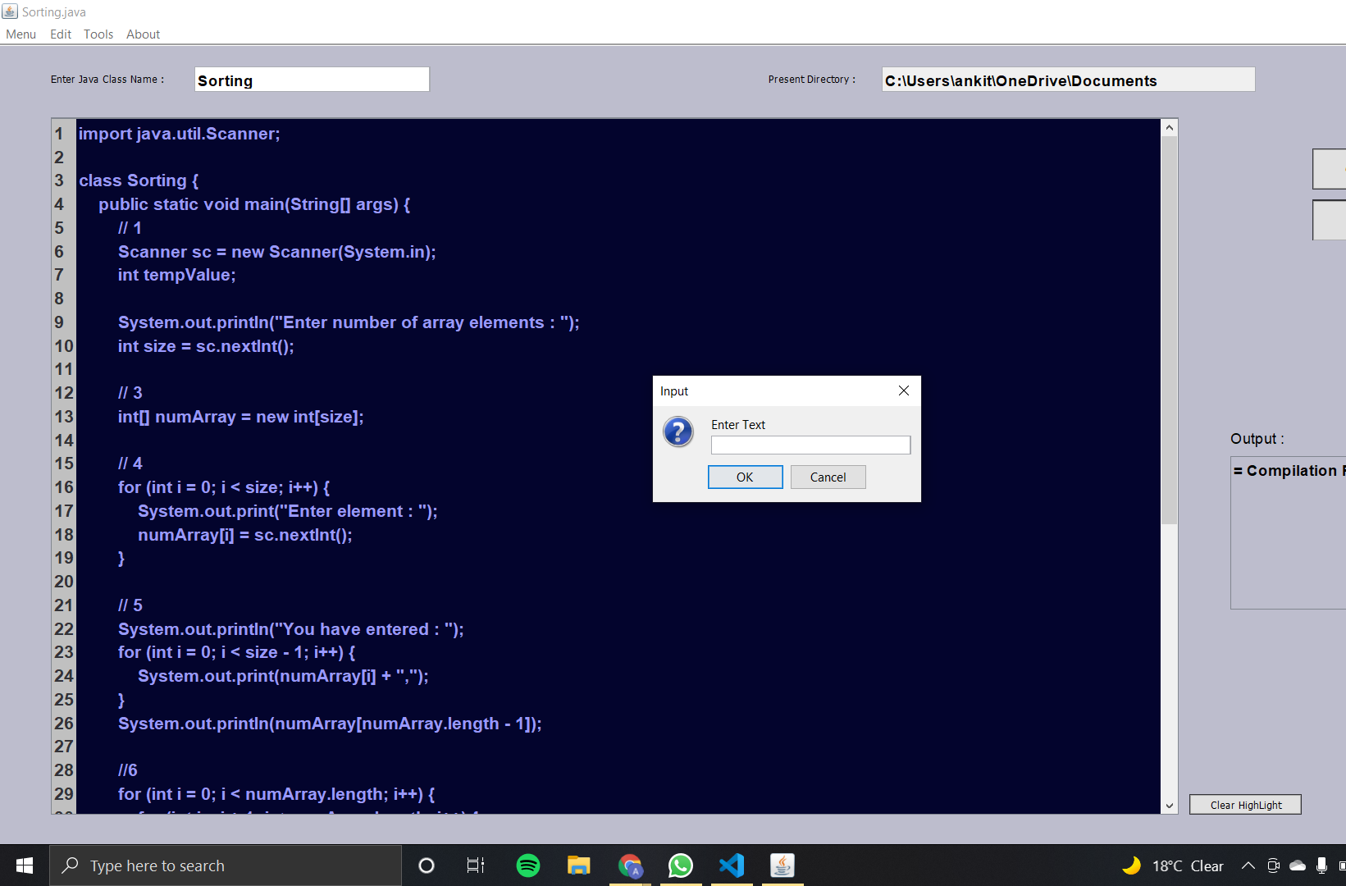
Finding a word

Slide 12
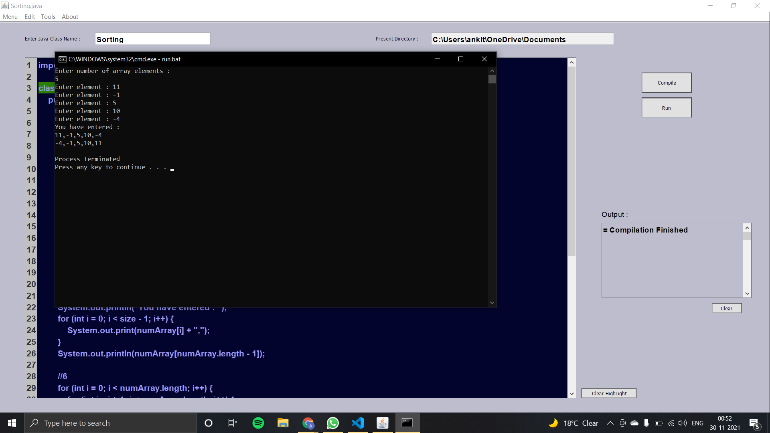
Output window

Slide 13
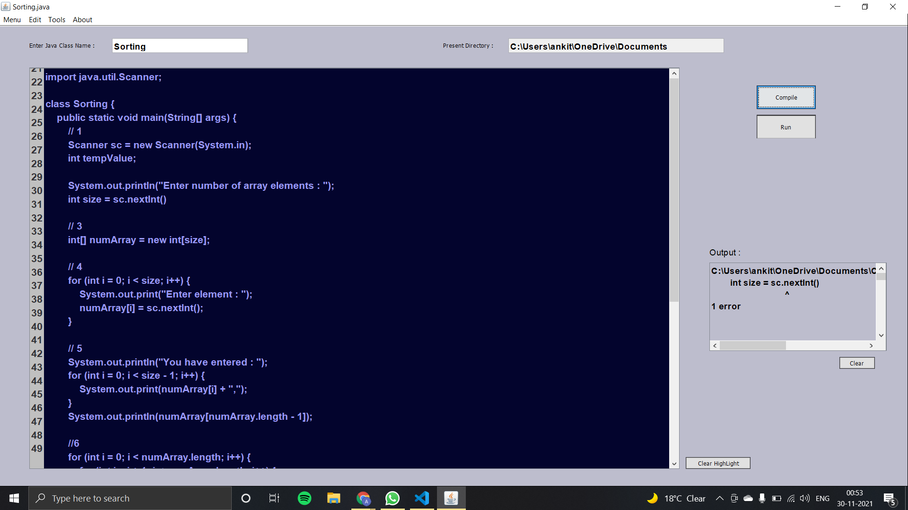
Compilation error

Slide 14
LIMITATIONS
For saving a file or editing then saving , you need to compile the program..
After searching for a specific letter, we need to click on clear highlights so that we could search for another one.

Slide 15
Acknowledgement
We would like to Thankyou Prof. OP Vyas and our Teaching Assistant Bagesh Kumar for giving us this project which help us to learn and enhance our knowledge in JAVA language, Swing and we learn a lot during building a project.

